Slide 1
Squamous Cell Carcinoma of the Esophagus

Slide 2

Anatomy
Food moves from the throat
$→$ esophagus
$→$ stomach
$→$ small bowel (jejunum)

Slide 3
Cancer Staging
Staging refers to the tests to determine
How large is the tumor?
Has there been spread to lymph nodes?
Has it spread to other parts of the body?
Treatment options depend upont the cancer stage

Slide 4
Esophageal Cancer Staging
T = Tumor - Depth of growth into the wall
N = Nodes - Spread to the lymph nodes
M = Metastasis - Spread to liver, lungs, or bone

Slide 5
Layers of the Wall of the Esophagus
Mucosa - Inner layer
Muscle wall (muscularis)
Lymph nodes located in fat outside the muscle

Slide 6
Early Stage Cancers
Cancers start on the very inside of the layer called the mucosa

Slide 7
Locally-advanced Cancers
Over time, cancers can grow into the muscular wall

Slide 8
Lymph Nodes
In some cases, cancer cells can break off from the main tumor and spread to lymph nodes

Slide 9

T Stage
Cancers are categorized based upon the thickness of the tumor, known as the T stage

Slide 10

N Stage
Cancers are categorized by whether there is spread to the lymph nodes.
N0 cancers have not spread to the lymph nodes
N1 cancers have spread to the lymph nodes.

Slide 11

M Stage
Some cancers spread from the esophagus to other parts of the body
M0 cancers have not spread to other parts of the body
N1 cancers have spread lungs, liver, or bone

Slide 12

PET scan
A PET scan is similar to a CT scan, and uses a small amount of tracer to light up areas of cancer.

Slide 13

Endoscopic Ultrasound
Similar to upper endoscopy (EGD)
Ultrasound probe in scope
Evaluates T stage of cancer

Slide 14
Treatment Plan
Superficial (T1) $⇒$ Endoscopic Therapy Localized (T1b/T2) $⇒$ Surgery Locally-advanced (T3) $⇒$ Chemo $±$ Radiation $→$Surgery Metastatic (M1) $⇒$ Chemotherapy

Slide 15
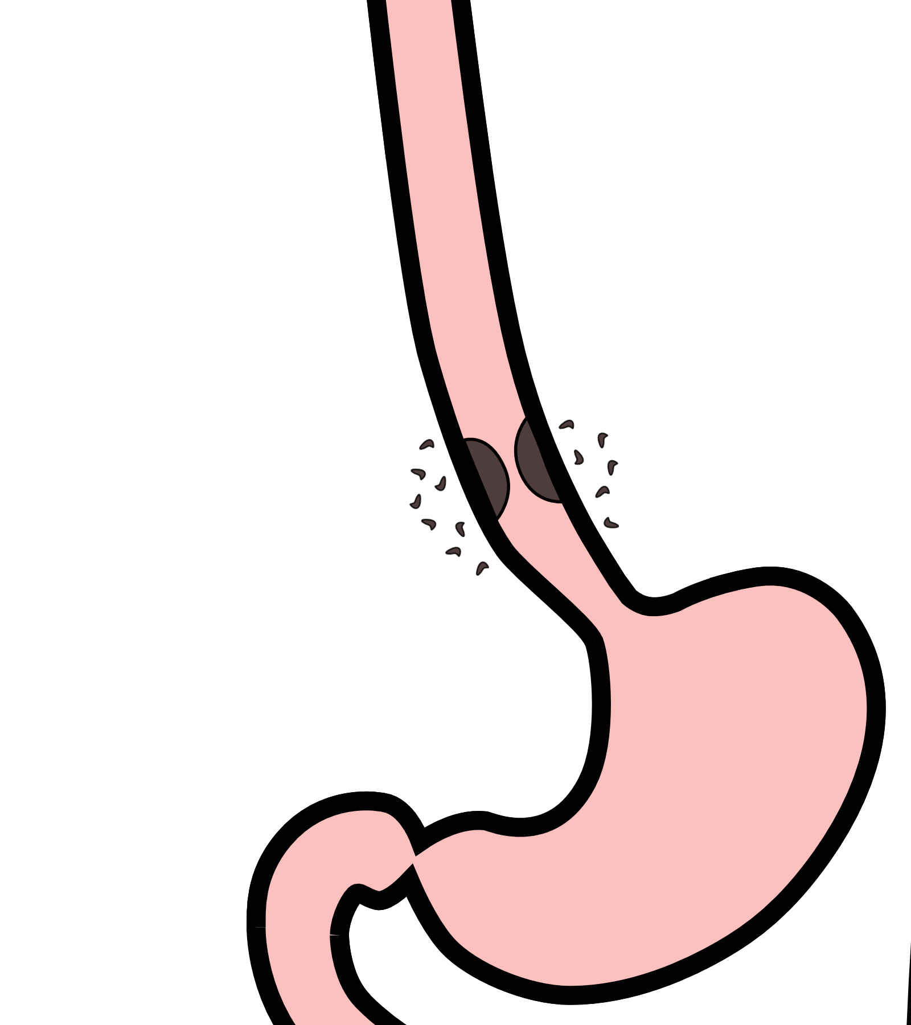
Locally-advanced cancers
Patients with locally-advanced esophageal cancer often have localized spread of cancer cells in the surrounding area

Slide 16
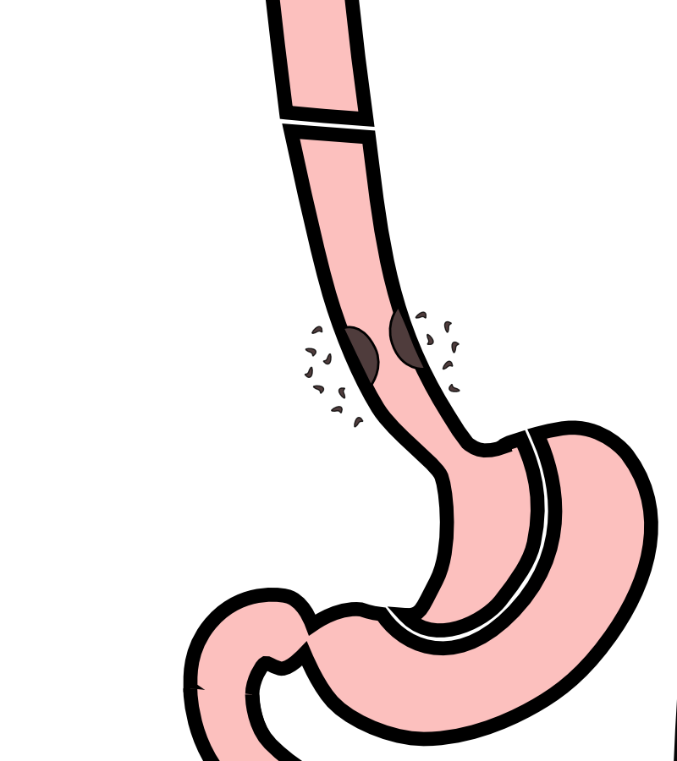
Locally-advanced cancers
If locally-advanced cancers are treated with surgery alone…

Slide 17
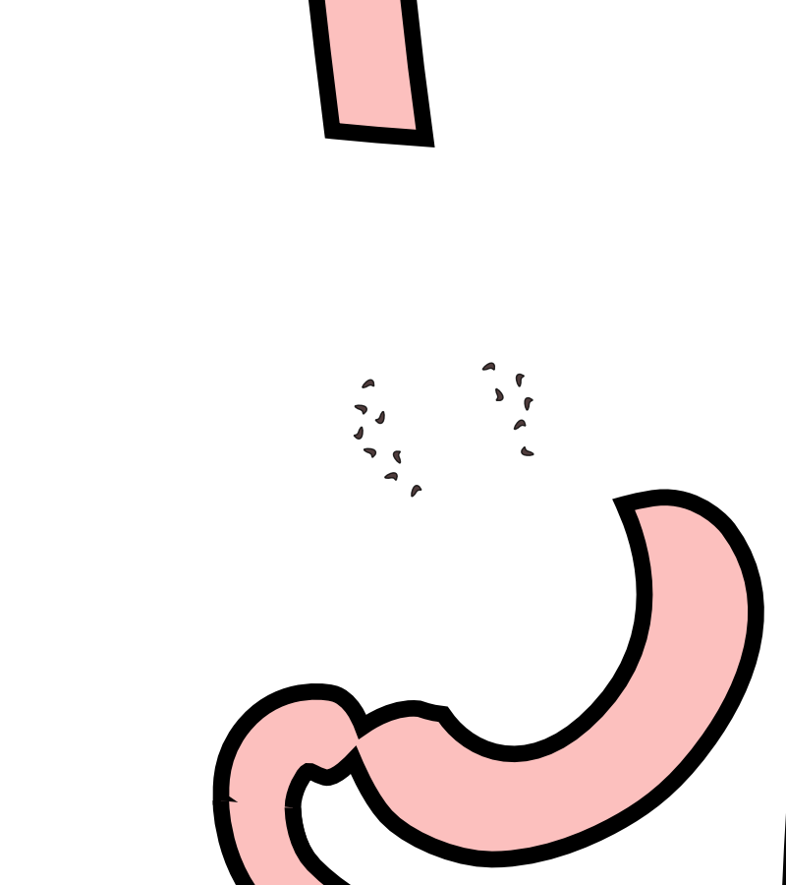
Locally-advanced cancers
If locally-advanced cancers are treated with surgery alone…
There is a risk that cancer cells can be left behind

Slide 18
Preoperative Therapy
It is helpful to start with therapy before surgery that will shrink the cancer.

Slide 19
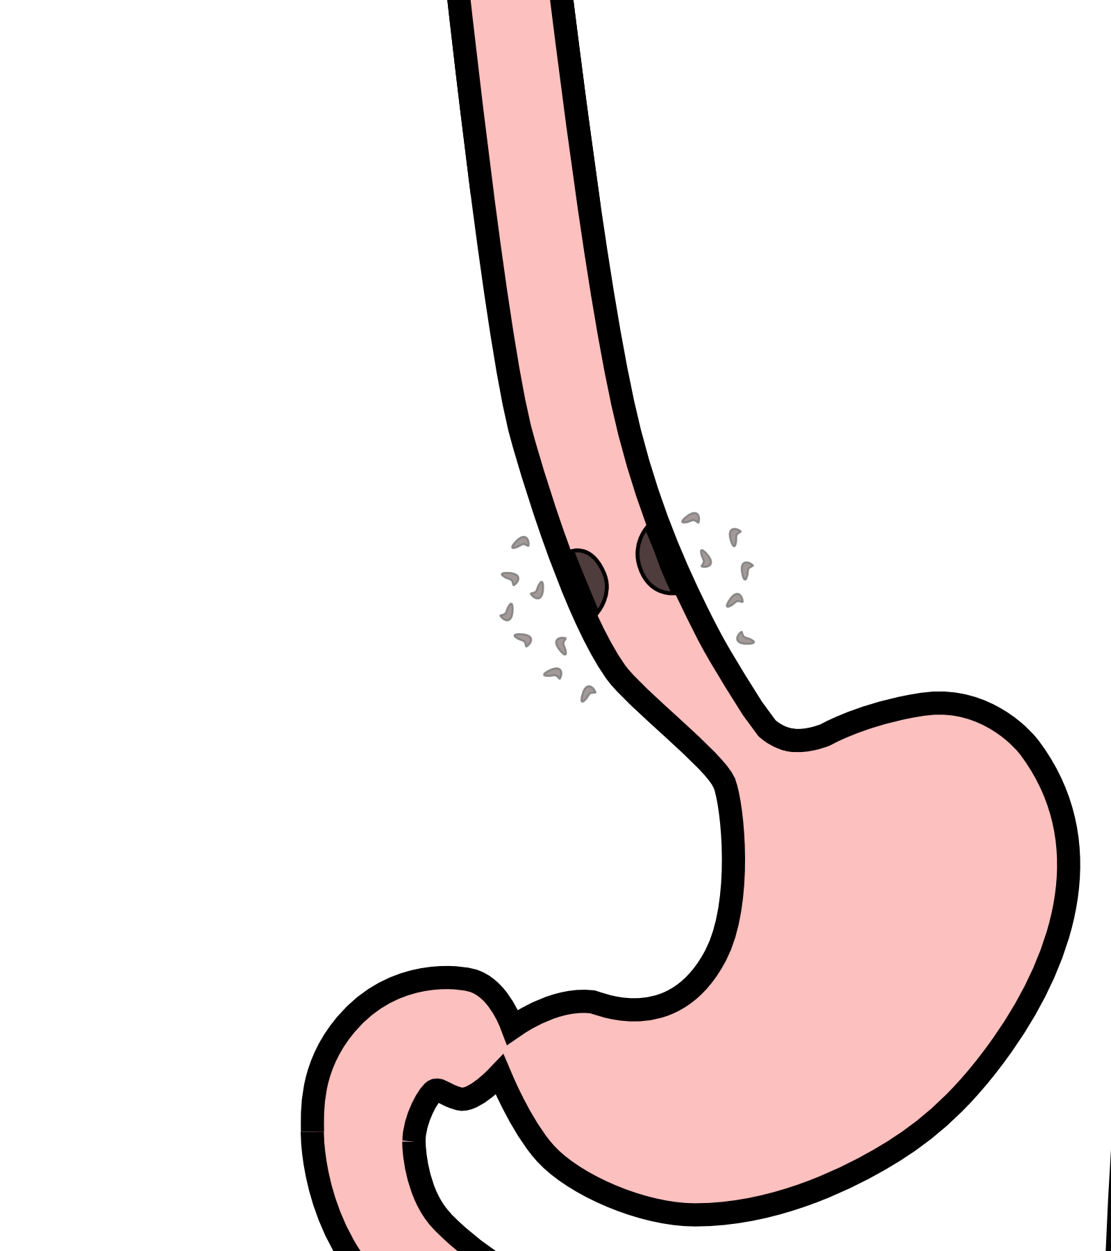
Preoperative Therapy
It is helpful to start with therapy before surgery that will shrink the cancer.

Slide 20

Preoperative Therapy
It is helpful to start with therapy before surgery that will shrink the cancer.

Slide 21
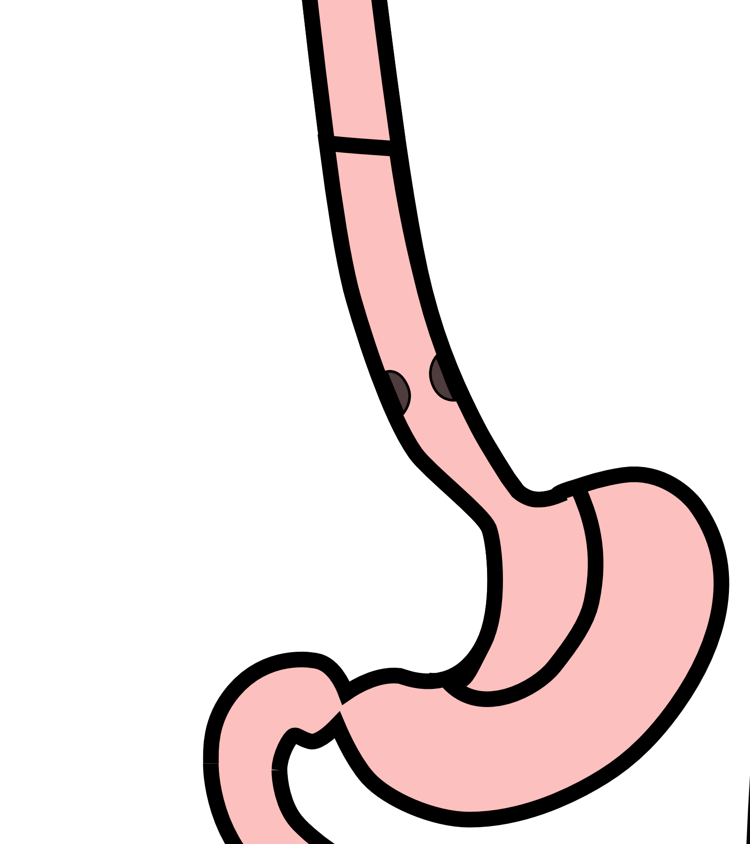
Surgery after Preoperative Therapy
When surgery is then performed…

Slide 22

Preoperative Therapy
When surgery is then performed…
The risk of cancer recurrence is minimized

Slide 23
Chemotherapy + Radiation CROSS Trial
363 patients with esophageal cancer studied
Patients were treated in two groups:
Surgery Alone
vs
Chemotherapy + Radiation $→$ Surgery

Slide 24
Chemotherapy + Radiation CROSS Trial
Chemotherapy + radiation given together for 6 weeks
Surgery Alone
vs
Chemotherapy + Radiation $→$ Surgery $⇒$ Longer Survival

Slide 25
Chemotherapy + Radiation CROSS Trial
Typical schedule for chemotherapy + radiation:
Chemotherapy once per week for 6 weeks
Radiation five days per week for 6 weeks (28)
PET scan (or CT) 4 weeks after the end of radiation
Surgery 8 weeks after the end of radiation

Slide 26
Chemotherapy + Radiation - Side Effects
Kills cancer cells in the esophagus and lymph nodes
Can also cause irritation of the lining of the esophagus.
Swallowing can be difficult the last 2 weeks
Feeding tube may be needed for nutrition

Slide 27
Chemotherapy
Chemotherapy drugs are administered intravenously.
There are several options for intravenous access:
Peripheral IVs in the hand
PICC line (Peripheral Inserted Central Catheter)
Central Venous Port
Central Venous Port

Slide 28
Restaging
CT or PET scan will be performed after preoperative therapy
Surgery performed after restaging
Timing depends upon recovery from therapy

Slide 29
Restaging Endoscopy after Chemo + Radiation
Endoscopy is performed to look for signs of persistent cancer
Biopsies are negative in approximately 75% of cases
Complete disappearance of cancer is only found in 40% of cases
$⇒$ cancer cells can hide in the wall of the esophagus

Slide 30
Surgery for Squamous Cell Carcinoma
Surgery is recommended for all patients who have:
Biopsies showing cancer after chemo + radiation
No signs of spread of disease on PET/CT scan
Healthy enough to undergo surgery

Slide 31
Surgery for Squamous Cell Carcinoma
Surgery is also recommended for patients who:
No signs of spread on disease on PET/CT scan
Cancer in the lower part of the esophagus
Healthy enough to undergo surgery

Slide 32
Surveillance if Surgery Not Performed
Upper endoscopy (EGD) every 3-6 months
PET every 6 months
$⇒$ Surgery a recurrence in the esophagus is found

Slide 33
Nutrition
Nutrition Slideshow

Slide 34
Surgery
Surgery Slideshow

